Slide 1



Green Tribology
Biodegradable oil Enhancement Techniques
Instructor
PRESENTED BY
Dr. Manjesh K. Singh
Chinmay Pratap
Devabrata Bothra
Amrit Kalash
Harsh Shah
Kartikeya Pandey
ME 698 T
Term paper presentation

Slide 2
Contents
Introduction
Experimental Setup and Surface preparation
Data Processing and Findings
Results and Findings
Conclusion
References
Acknowledgement

Slide 3

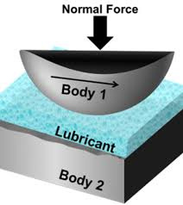

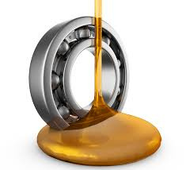
Introduction
Green Tribology is defined as the science and technology of the tribological aspects of ecological balance and of environmental impacts.
With the viewpoint of sustainable development of resources and environment, the main objectives of green tribology are:
1. the environment-friendly saving of energy and materials,
2. the enhancement of the environment and quality of life.
Our project delves into the lubrication aspect of tribology and tries to address the current challenges from the point of view of green tribology.

Slide 4




Introduction (cont’d)
Purpose of Lubrication:
Reduce friction between moving surfaces via a low shear strength film.
Conventional Lubricants:
Mineral oils, synthetic oils, and greases
Non-biodegradable → Harmful effects:
Water contamination
Soil degradation
Toxicity to aquatic life
Sustainable Alternative:
Plant-based lubricants
Biodegradable
Environmentally safe

Slide 5
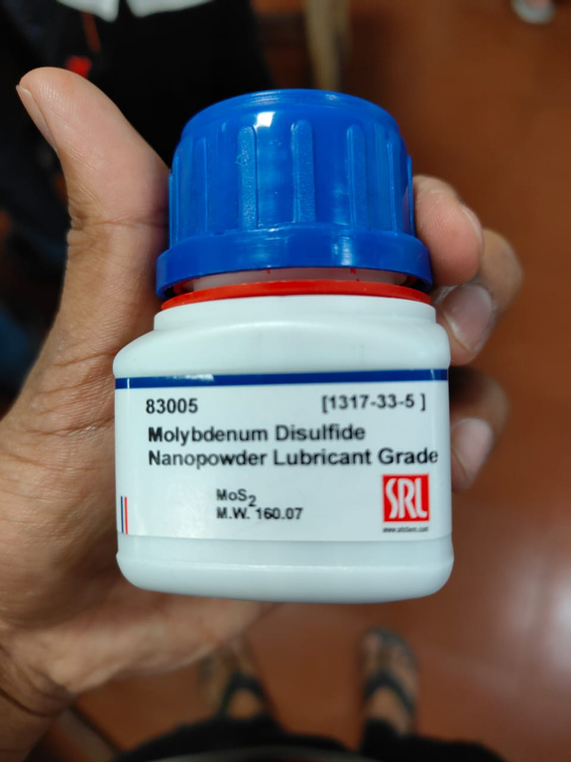
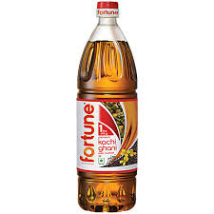
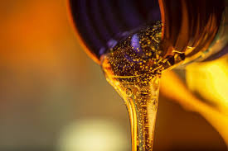
Introduction (cont’d)
Biodegradable Lubricant Used:
Mustard oil.
Goal: Analyze Coefficient of Friction (COF) between 2 steel samples using Linear Reciprocating Tribometer at 2 different temperatures.
Addition of MoS₂ nanoparticles as a solid lubricant.
Observe its effect on COF values.

Slide 6
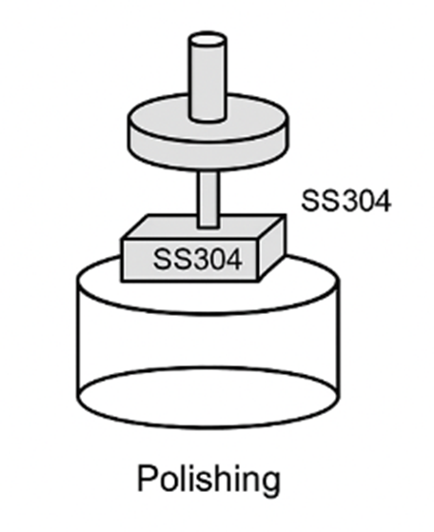
Experimental Setup & Surface Preparation
1. Polishing Stage
Equipment: Wet polishing machine (200 RPM), 320 & 1200-grit abrasives
Purpose: Smooth, uniform surface on SS304 plate
Why: Ensures consistent surface finish, minimizing artifacts in friction/wear tests
2. Cleaning Process
Method: Acetone cleaning post-polishing
Why: Removes oil, debris, and abrasive residues for contamination-free testing
Fig: Schematic diagram

Slide 7
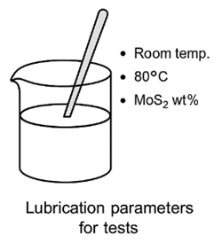
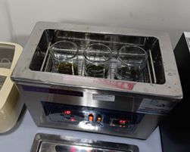
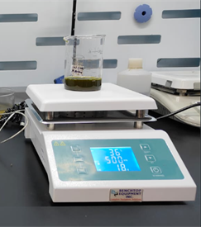
Experimental Setup & Surface Preparation
1. Hand Stirring
0.05g, 0.25g, 0.5g of MoS₂ added to 50 ml mustard oil → 0.1%, 0.5%, 1.0% solutions.
Reason: Initial dispersion of MoS₂.
2. Ultrasonic Bath
Conditions: 44 °C for 20 minutes
Purpose: Final homogenization of MoS₂ in mustard oil
Why: Breaks agglomerates from manual/magnetic stirring to ensure uniform, stable MoS₂ dispersion
3. Magnetic Stirring (30°C, 10 mins)​ at 500 RPM
Purpose: Homogenize solution.​
Reason: Prevent clumping of particles.

Slide 8
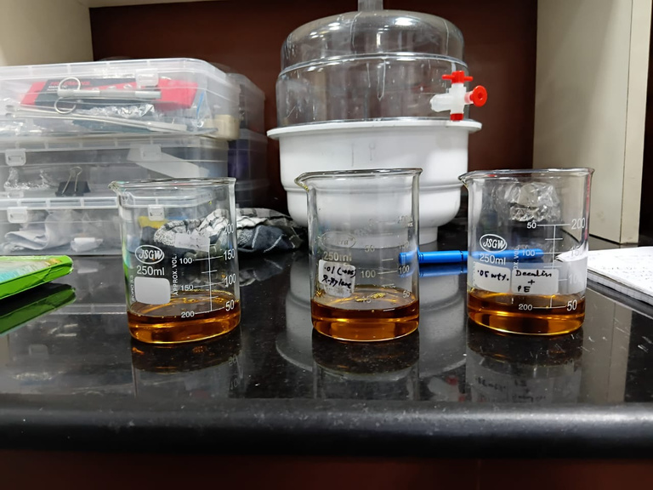
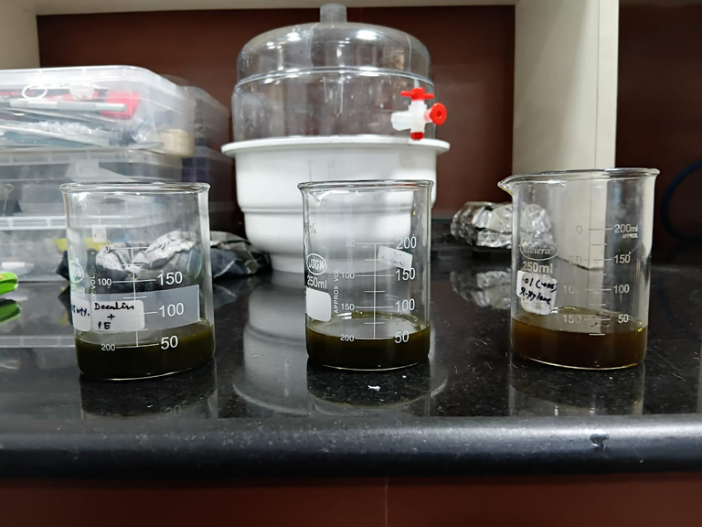
Experimental Setup & Surface Preparation
Visual Appearance
Uniform dark gray to black (varies with MoS₂ concentration)
Smooth consistency; no visible sedimentation or clumps
Slight metallic shimmer due to nano-MoS₂ dispersion
Stability Indicators
No floating particles or undissolved flakes
Homogeneous color, even after swirling
Noticeable viscosity increase at higher MoS₂ wt%
Fig: Before adding MoS2
Fig: After adding MoS2

Slide 9
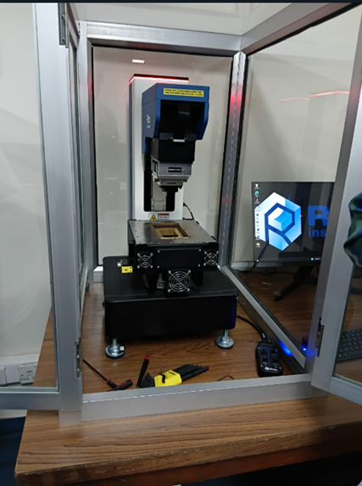
Experimental Setup & Surface Preparation
Linear Reciprocating Tribometer Testing
Tribometer Parameters
Specimen: SS304 plate + AISI 52100 ball.
Load: 5 N
Principal Hertizian Stress: 1199.3 MPa
Frequency: 4 Hz
Stroke Length: 2 mm
Temperature: 30°C (Room Temp), 80°C (Elevated)
Duration: Fixed time across all tests
Reasoning: To meet real-world sliding conditions and quantify friction behavior across temp and composition variations at specific parameters.
Fig: Linear Reciprotating Tribometer

Slide 10
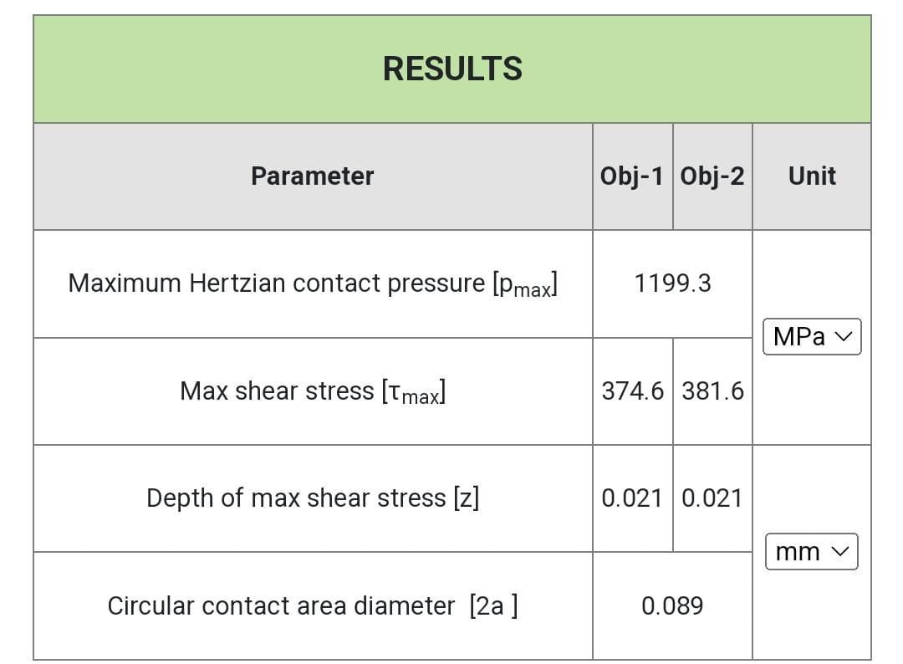


Experimental Setup & Surface Preparation

Slide 11
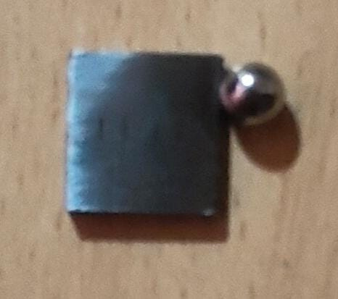
Experimental Setup & Surface Preparation
Post test Characterization method
Rheological Characterization
Observations:
1% MoS₂ had higher viscosity, but no linear trend in frictional benefit
Tribological Characterization
Data from Tribometer:
CoF trends (min @ 0.1%, rise at 0.5%)
Fig: SS304 Samples

Slide 12
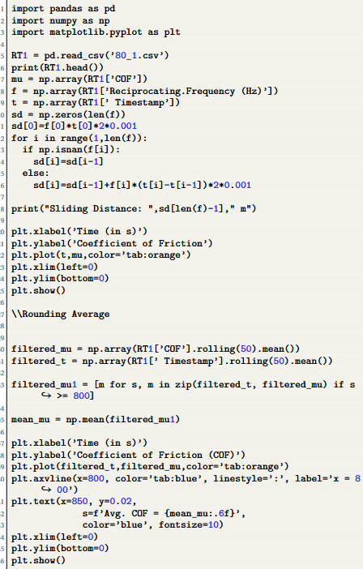
Data Processing & Findings
Data Processing
Exported raw data from the software
Calculated Coefficient of Friction (COF) for each case.
Plotted COF against temperature variation for comparison and trend analysis.
Implemented the Rolling average to filter the COF value.
Measured the average COF value.
Fig: Code Snippet

Slide 13
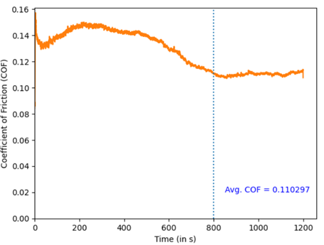
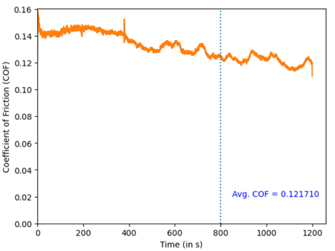
Results and Discussion
Fig: Room Temperature (Pure oil)
Fig: 80 C (Pure oil)

Slide 14
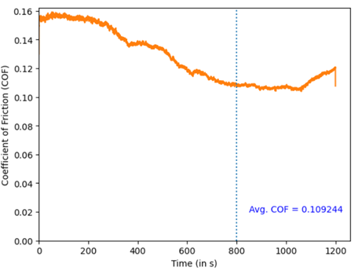
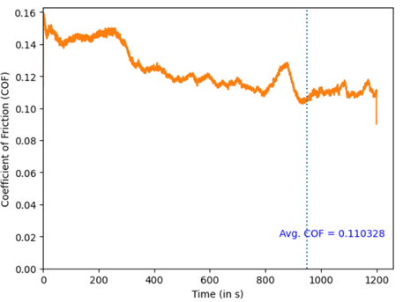
Results and Discussion
Fig: Room Temperature (0.1 % MoS2)
Fig: 80 C (0.1% MoS2)

Slide 15
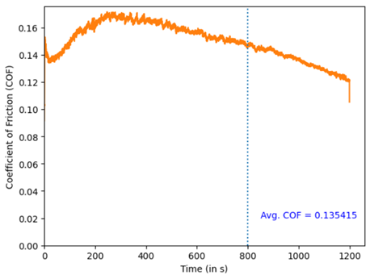
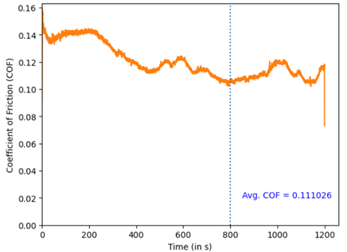
Results and Discussion
Fig: Room Temperature (0.5 % MoS2)
Fig: 80 C (0.5% MoS2)

Slide 16
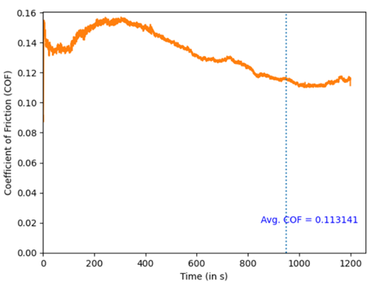
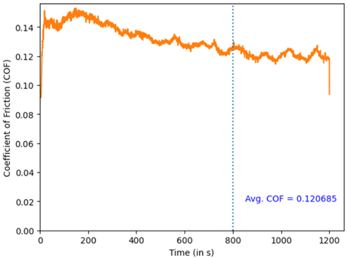
Results and Discussion
Fig: Room Temperature (1 % MoS2)
Fig: 80 C (1% MoS2)

Slide 17
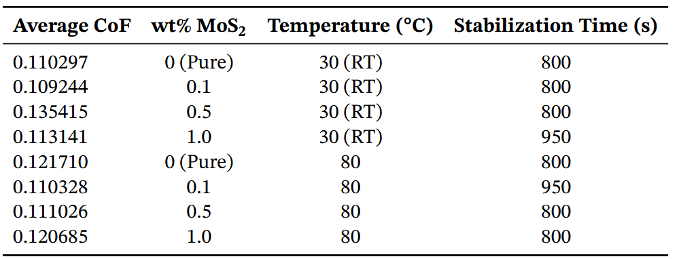
Results and Discussion
Fig: Summary Table

Slide 18
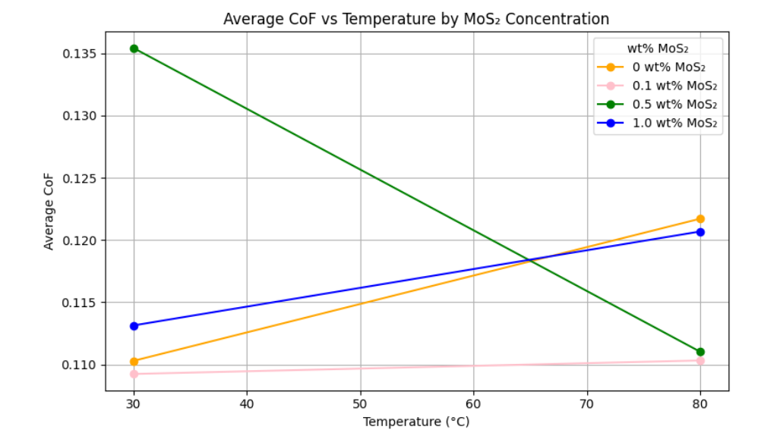
Conclusion
Key Observations
(i) Average CoF Ranges from 0.109 to 0.135 which is significantly lower than the dry CoF value (0.45~0.6)
(ii) Effect of MoS₂ Concentration:
Initial MoS₂ addition reduced CoF at both low & high temperatures
At higher concentrations CoF were higher for lower temperature but were lower for higher temperature
Fig: Plot COF Vs Temp.

Slide 19
Conclusion
Key Observations
Anomalous Behavior – 0.5 wt% MoS₂ at Room Temperature
Unlike other samples, CoF did not stabilize
Displayed a monotonically decreasing trend throughout the test
Error Sources
Possible Causes – 0.5 wt% MoS₂ Anomaly (RT):
MoS₂ Structure: Layered hexagonal structure increases interparticle interaction → lower dispersion stability at intermediate concentration
Stability Issue @ RT: 0.5 wt% may be high enough for settling in mustard oil at room temp
Tribometer Error: Potential heating system malfunction → uneven temperature affecting CoF
Surface Roughness: Localized anomaly may have disrupted lubricant film

Slide 20
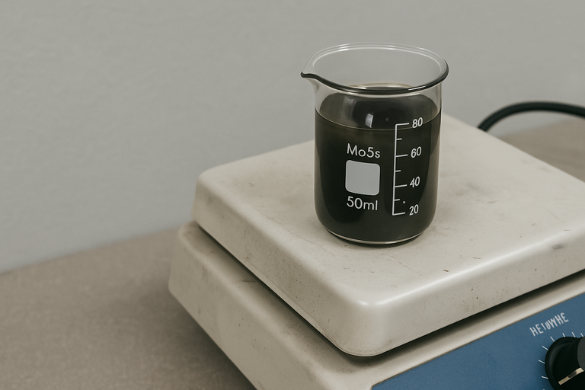
Conclusion
Prevention Measures
Immediate Use: Use samples right after preparation to avoid settling, for later use, samples should be stirred just before the experiment.
Improve Dispersion:
If unstable, use a surfactant (e.g., CTAB) to stabilize MoS₂ via electrostatic repulsion
Heating System Check:
Ensure proper calibration and uniform heating
Let tribometer stabilize at set temperature before testing
Specimen Handling:
Use fresh specimens whenever possible or at different locations for the same specimen
Multiple tests should be conducted for same lubricant at similar conditions to avoid any system error.

Slide 21
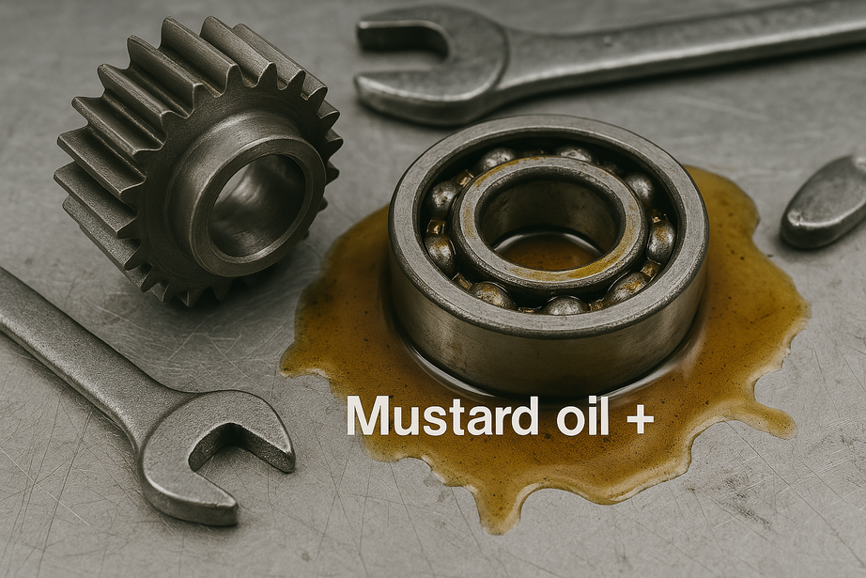
Conclusion
Potential to be used
Industrial Suitability of Natural Lubricant (Mustard Oil + MoS₂)
Competitive average CoF: 0.11–0.12, comparable to synthetic lubricants (boundary lubrication)
MoS₂ addition improves anti-wear, load capacity & friction reduction
Natural lubricity from fatty acids enhances wettability
High flash point → lower fire risk in industrial settings

Slide 22

Conclusion
Eco-friendly benefits
Biodegradable within 28 days (OECD 301B) → minimal long-term pollution
Non-toxic to aquatic life vs. hazardous mineral oils
MoS₂: Inert and safe in small concentrations
Free of PAHs, sulfur compounds, heavy metals → cleaner disposal
Plant-derived & renewable → reduces reliance on fossil fuels
Lower life-cycle emissions from production to disposal

Slide 23
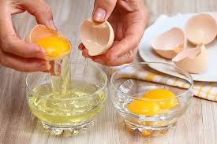


Future Direction
Future Direction
More Eco-friendly Lubricants
Exploring Other Natural Lubricants for Sustainable Tribology
Aloe Vera Gel & Egg White were also considered as potential natural lubricants
These bio-based alternatives can be enhanced (e.g., with MoS₂) for improved performance
Offer eco-friendly, biodegradable, and non-toxic solutions for industrial applications
Align with goals of sustainable development in real-world tribological systems
Promote low environmental impact and reduced pollution in lubrication technology

Slide 24
References
Future Direction
1] Y. Hori, “A theory of oil whip”, 1959.
[2] W. O. Winer, “Molybdenum disulfide as a lubricant: A reviewof the fundamental knowledge”, Wear, vol. 10, no. 6, pp. 422–452, 1967.
[3] A. Willing, “Lubricants based on renewable resources–an environmentally compatible alternative to mineral oil products”,Chemosphere, vol. 43, no. 1, pp. 89–98, 2001.
[4] S. Boyde, “Green lubricants. environmental benefits and impacts of lubrication”, Green Chemistry, vol. 4, no. 4, pp. 293307, 2002.
[5] J. H. Hamman, “Composition and applications of aloe vera leafgel”, Molecules, vol. 13, no. 8, pp. 1599–1616, 2008.
[6] C. Betton, “Lubricants and their environmental impact”, Chem-istry and technology of lubricants, pp. 435–457, 2010.
[7] M. Nosonovsky and B. Bhushan, Green tribology: Principles,research areas and challenges, 2010.
[8] Bharat. “Wikipedia”. Accessed: 2025-04-05. (2012), [Online].Available: https://en.wikipedia.org/wiki/Tribology.
[9] Available at : https://pubs.acs.org/doi/10.1021/acs.jpcc.8b05922
[10] Availablr at: https://pubs.rsc.org/en/content/articlehtml/2020/ra/d0ra03414

Slide 25

Acknowledgement
We sincerely thank Dr. Manjesh K. Singh for his invaluable guidance and for providing us the opportunity to work on this project.
Our heartfelt appreciation to the Tribology Lab Team —Mr. Kuldeep, Mr. Ajay, Mr. Susheel, Mr. Arun, and others for their constant support and assistance with the experimental setup.
We also extend our gratitude to the Department of Mechanical Engineering, IIT Kanpur for offering the platform and resources to carry out this research.

Slide 26


Slide 27


